Slide 1
Algorithms: Dynamic Programming 0-1 Knapsack Problem
Course Code: CSE-2218
Data Structure and Algorithms II Lab
Lec Saifur Rahman
Email: saifur@cse.uiu.ac.bd
Mobile: +8801303529289

Slide 2


The Knapsack Problem
There are two versions of this problem:
“0-1 knapsack problem” Items are indivisible: you either take an item or not. Solved with dynamic programming.
“Fractional knapsack problem” Items are divisible: you can take any fraction of an item. Solved with a greedy algorithm.

Slide 3
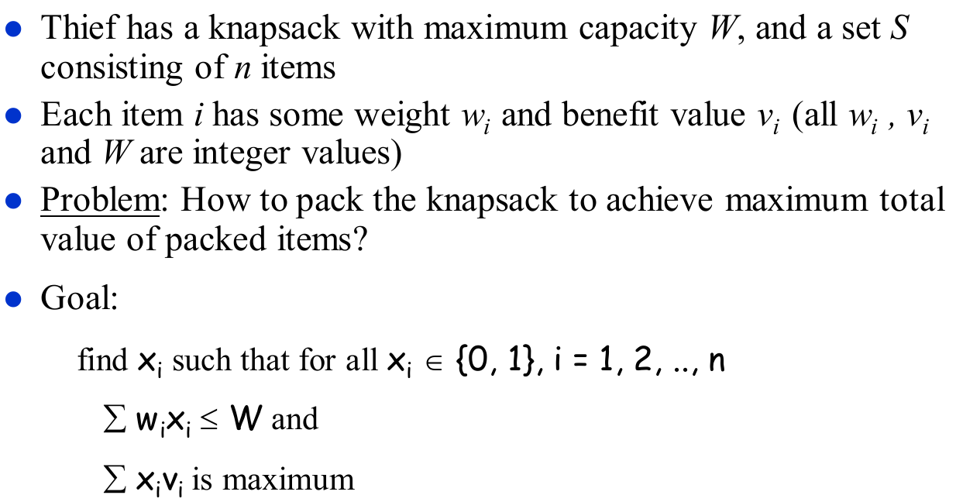
0-1 Knapsack Problem

Slide 4

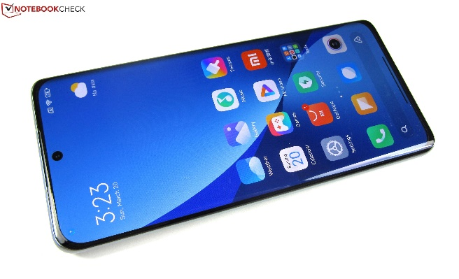
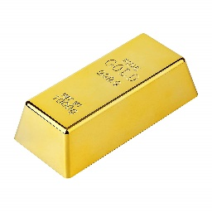
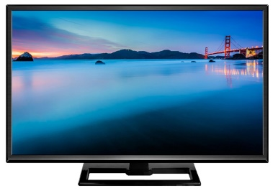


0/1 knapsack problem
$ 3
$ 4
$ 5
$ 6
2 Kg
3 Kg
4 Kg
5 Kg
5 Kg

Slide 5
0/1 knapsack problem
$ 3
$ 4
$ 5
$ 6
2 Kg
3 Kg
4 Kg
5 Kg
5 Kg

Slide 6
0/1 knapsack problem
$ 3
$ 4
$ 5
$ 6
2 Kg
3 Kg
4 Kg
5 Kg
5 Kg

Slide 7
0/1 knapsack problem
$ 3
$ 4
$ 5
$ 6
2 Kg
3 Kg
4 Kg
5 Kg
5 Kg

Slide 8
0/1 knapsack problem
$ 3
$ 4
$ 5
$ 6
2 Kg
3 Kg
4 Kg
5 Kg
5 Kg

Slide 9
0/1 knapsack problem
$ 3
$ 4
$ 5
$ 6
2 Kg
3 Kg
4 Kg
5 Kg
Which items would you steal?
Don’t be GREEDY
5 Kg

Slide 10
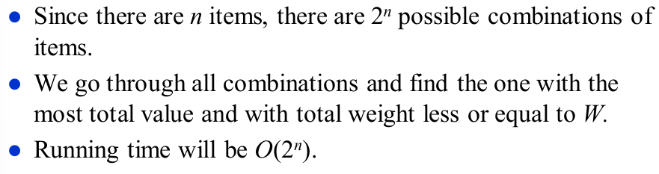
0-1 Knapsack: Brute-Force Approach

Slide 11
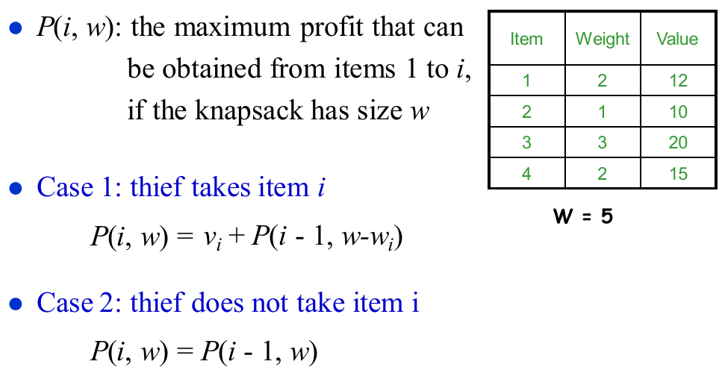
0-1 Knapsack: Dynamic Programming

Slide 12
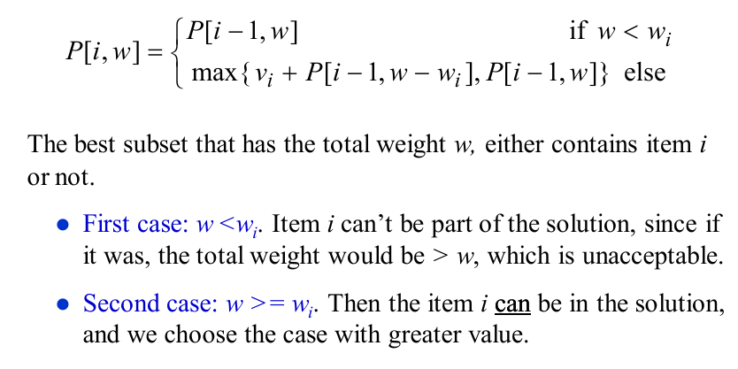
0-1 Knapsack: Recursive Formula

Slide 13



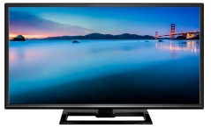
Problem Formulation
What’s the maximum amount can the thief with a bag with 5Kg of capacity steal from the 4 items?
K (5 kg, 4 items)
K ( w, n )
$ 4
$ 5
$ 6
$ 3
2 Kg
3 Kg
4 Kg
5 Kg
5 Kg
Observe where the thief is standing

Slide 14
Problem Formulation
What’s the maximum amount can the thief with a bag with 5Kg of capacity steal from the 4 items?
K (2 kg, 2 items)
K ( w, n )
$ 4
$ 5
$ 6
$ 3
2 Kg
3 Kg
4 Kg
5 Kg
2 Kg
Observe where the thief is standing

Slide 15
Yes, we can solve it recursively.
$ 4
$ 5
$ 6
$ 3
k(5,4)
2 Kg
3 Kg
4 Kg
5 Kg
0
6
k(5,3)
k(0,3)
5
0
k(5,2)
k(1,2)
0
4
0
k(5,1)
k(2,1)
k(1,1)
4
0
3
0
3
0
3
k(5,0)
k(3,0)
k(2,0)
k(0,0)
k(1,0)
k(1-2,0)
k(1-3,1)
0
0
0
0
0

Slide 16
Yes, we can solve it recursively.
$ 4
$ 5
$ 6
7
$ 3
k(5,4)
2 Kg
3 Kg
4 Kg
5 Kg
0
7
0
6
k(5,3)
k(0,3)
Problems with this approach:
1. Recursion takes a lot of time (does the same work again and again due to overlapping sub problems property).
2. No table, hence no way to trace the sequence of actions.
3. Overlapping subproblems?
5
0
7
0
k(5,2)
k(1,2)
3
0
4
3
0
0
k(5,1)
k(2,1)
k(1,1)
0
0
3
3
0
0
3
0
0
0
k(5,0)
k(3,0)
k(2,0)
k(0,0)
k(1,0)
0
0
0
0
0

Slide 17
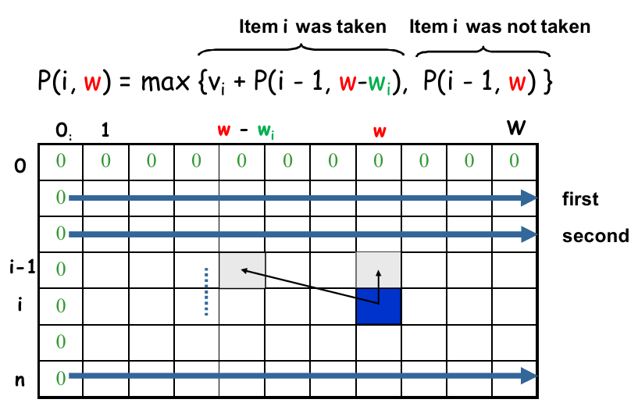
Dependencies among Subproblems

Slide 18
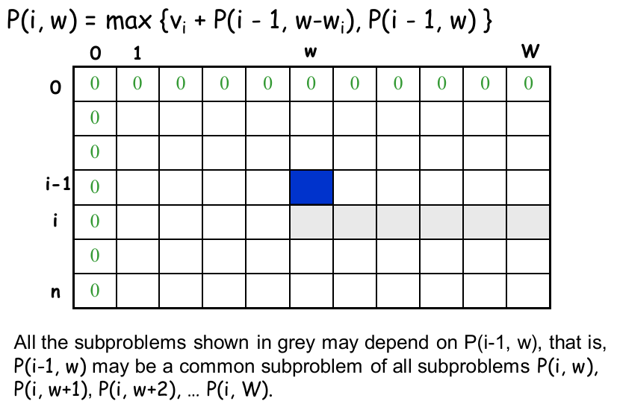
Overlapping Subproblems

Slide 19
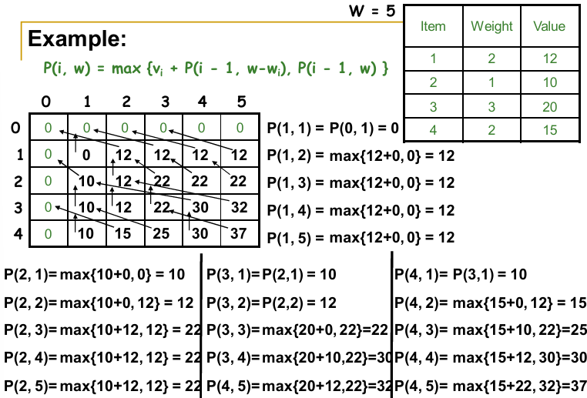

Slide 21
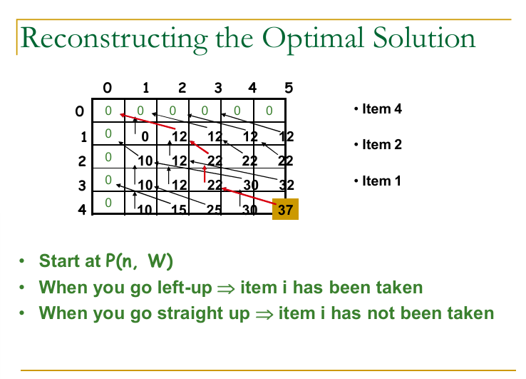

Slide 22
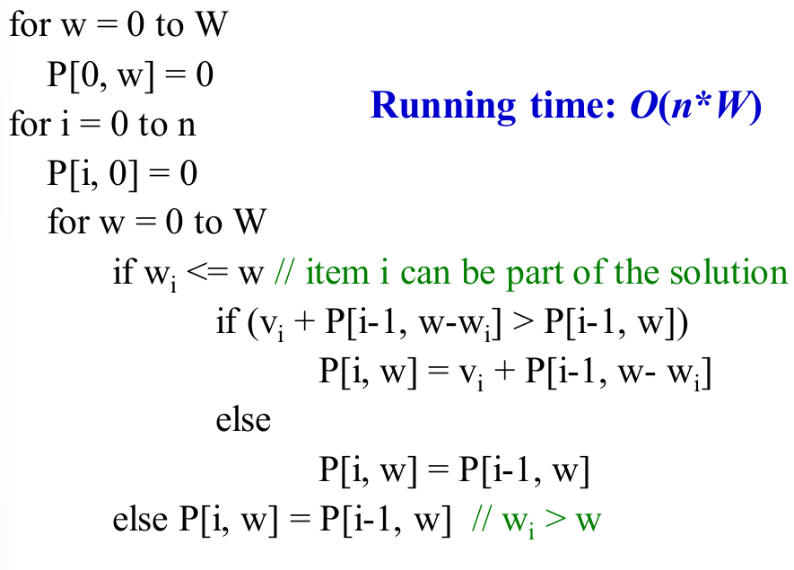
0-1 Knapsack: DP

